Slide 1
Bioinformatics Pairwise Sequence Alignment
Assoc. Prof. Dr. Gazi Erkan BOSTANCI
Slides are mainly based on ‘Understanding Bioinformatics’ by Marketa Zvelebil and Jeremy O. Baum

Slide 2
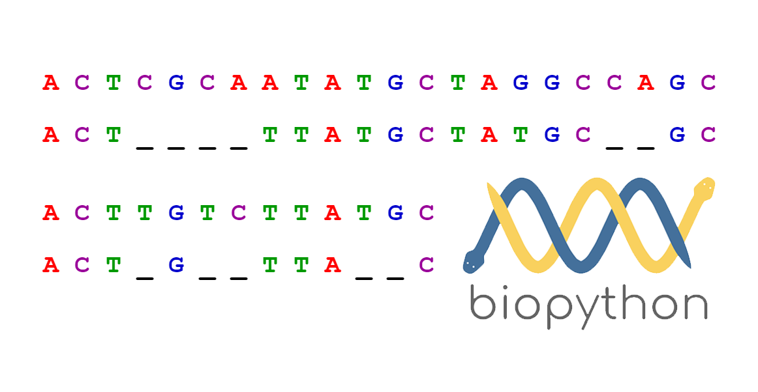
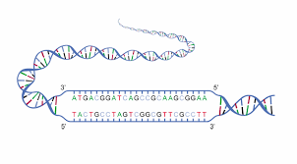
Given two sequences, and allowing gaps to be inserted, it is possible to construct a very large number of alignments.
Of these, there will be an optimal alignment, which in the ideal case perfectly identifies the true equivalences between the sequences.

Slide 3
However, there will be many alternative alignments with varying degrees of error that could potentially be seriously misleading.
Furthermore, the fact that an alignment can be constructed for any two sequences, even ones with no meaningful equivalences, has the potential to be even more misleading.
Therefore, all useful methods of sequence alignment must not only generate alignments but also be able to compare them in a meaningful way and to provide an assessment of their significance.

Slide 4
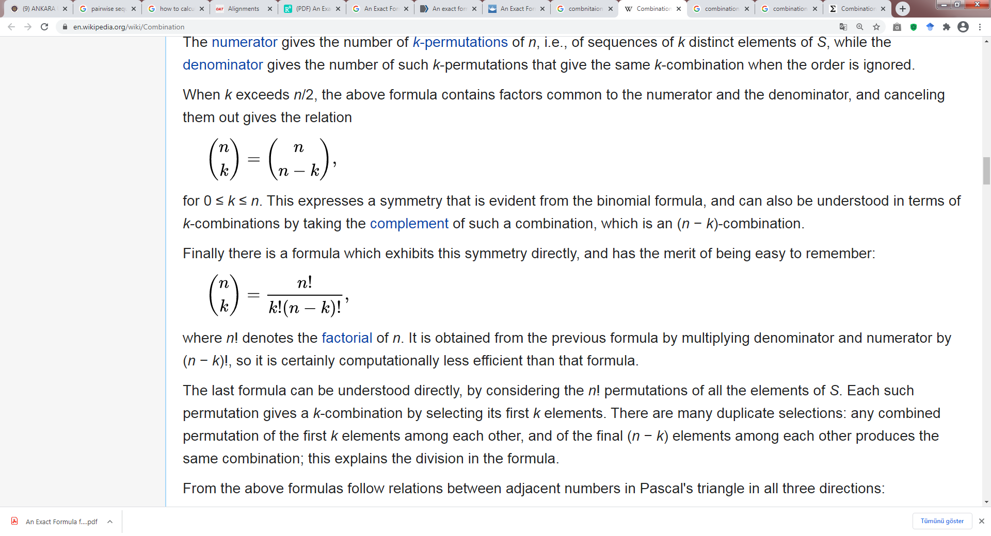
The number of alternative alignments is so great, however, that efficient methods are required to determine those with optimal scores. Fortunately, algorithms have been derived that can be guaranteed to identify the optimal alignment between two sequences for a given scoring scheme.

Slide 5
As long as only single proteins or genes, or small segments of genomes, are aligned, these methods can be applied with ease on today’s computers.
When searching for alignments of a query sequence with a whole database of sequences it is usual practice to use more approximate methods that speed up the search.

Slide 6
Finding the best-scoring alignment between two sequences does not guarantee the alignment has any scientific validity. Ways must be found to discriminate between fortuitously good alignments and those due to a real evolutionary relationship.
The large number of complete genome sequences has led to increased interest in aligning very long sequences such as whole genomes and chromosomes.
These applications require a number of approximations and techniques to increase the speed and reduce the storage requirements.

Slide 7
Dynamic Programming Algorithms
For any given pair of sequences, if gaps are allowed there is a large number of possibilities to consider in determining the best-scoring alignment.
For example, two sequences of length 1000 have approximately 10⁶⁰⁰ different alignments, vastly more than there are particles in the universe! Given the number and length of known sequences it would seem impossible to explore all these possibilities.
Nevertheless, a class of algorithms has been introduced that is able to efficiently explore the full range of alignments under a variety of different constraints. They are known as dynamic programming algorithms, and efficiently avoid needless exploration of the majority of alignments that can be shown to be nonoptimal.

Slide 8
The key property of dynamic programming is that the problem can be divided into many smaller parts. Consider the following alignment:
in which the subscripts u, v, etc. refer to alignment positions rather than residue types, so that X_{u}, Y_{v}, and so on each correspond to a residue or to a gap.
The alignment has been divided into three parts, with positions labeled 1 -> u, u + 1 -> v, and v + 1 -> L.
Because scores for the individual positions are added together, the score of the whole alignment is the sum of the scores of the three parts; that is, their contributions to the score are independent. Thus, the optimal global alignment can be reduced to the problem of determining the optimal alignments of smaller sections.

Slide 9
A corollary to this is that the global optimal alignment will not contain parts that are not themselves optimal. While affine gap penalties require a slightly more sophisticated argument, essentially the same property holds true for them as well.
Starting with sufficiently short sub-sequences, for example the first residue of each sequence, the optimal alignment can easily be determined, allowing for all possible gaps.
Subsequently, further residues can be added to this, at most one from each sequence at any step. At each stage, the previously determined optimal subsequence alignment can be assumed to persist, so only the score for adding the next residue needs to be investigated.
A worked example later in the section will make this clear. In this way, the optimal global alignment can be grown from one end of the sequence.
As an alignment of two sequences will consist of pairs of aligned residues, a rectangular matrix can conveniently represent these, with rows corresponding to the residues of one sequence, and columns to those of the other.

Slide 10
Until the global optimal alignment has been obtained, it is not known which actual residues are aligned. All possibilities must be considered or the optimal alignment could be missed. This is not as impossible as it might seem.
Saul Needleman and Christian Wunsch published the original dynamic programming application in this field in 1970, since then many variations and improvements have been made, some of which will be described here. There have been three different motivations for developing these modifications:
Firstly, global and local alignments require slightly different algorithms.
Secondly, but less commonly, certain gap-penalty functions and the desire to optimize scoring parameters have resulted in further new schemes.
Lastly, especially in the past, the computational requirements of the algorithms prevented some general applications. For example, the basic technique in a standard implementation requires computer memory proportional to the product m*n for two sequences of length m and n. Some algorithms have been proposed that reduce this demand considerably.

Slide 11
Optimal global alignments are produced using efficient variations of the Needleman–Wunsch algorithm
We will introduce dynamic programming methods by describing their use to find optimal global alignments. Needleman and Wunsch were the first to propose this method, but the algorithm given here is not their original one, because significantly faster methods of achieving the same goal have since been developed.
The problem is to align sequence x (x₁x₂x₃…x_{m}) and sequence y (y₁y₂y₃…y_{n}), finding the best scoring alignment in which all residues of both sequences are included. The score will be assumed to be a measure of similarity, so that the highest score is desired.

Slide 12
The key concept in all these algorithms is the matrix S of optimal scores of subsequence alignments. The matrix has (m + 1) rows labeled 0 -> m and (n + 1) columns labeled 0 -> n.
The rows correspond to the residues of sequence x, and the columns to those of sequence y. We shall use as a working example the alignment of the sequences x = THISLINE and y = ISALIGNED, with the BLOSUM-62 substitution matrix as the scoring matrix.

Slide 13
The BLOSUM-62 substitution matrix scores in half bits.
Scores that would be given to identical matched residues are in blue; positive scores for nonidentical matched residues are in red.
The latter represent pairs of residues for which substitutions were observed relatively often in the aligned reference sequences.

Slide 14
Because the sequences are small they can be aligned manually, and so we can see that the optimal alignment is:
This alignment might not produce the optimal score if the gap penalty were set very high relative to the substitution matrix values, but in this case it could be argued that the scoring parameters would then not be appropriate for the problem.
In the matrix in figure below, the element S_{i,j} is used to store the score for the optimal alignment of all residues up to x_{i} of sequence x with all residues up to y_{j} of sequence y.

Slide 15
The initial stage of filling in the dynamic programming matrix to find the optimal global alignment of the two sequences THISLINE and ISALIGNED.
The initial stage of filling in the matrix depends only on the linear gap penalty with E set to –8.
The arrows indicate the cell(s) to which each cell value contributes.

Slide 16
The sequences (x₁x₂x₃…x_{i}) and (y₁y₂y₃…y_{j}) with i < m and j < n are called subsequences. Column S_{i,0} and row S_{0,j} correspond to the alignment of the first i or j residues with the same number of gaps. Thus, element S_{0,3} is the score for aligning sub-sequence y₁y₂y₃ with a gap of length 3.
To fill in this matrix, one starts by aligning the beginning of each sequence; that is, in the extreme upper left-hand corner.
The elements S_{i,0} and S_{0,j} are easy to fill in, because there is only one possible alignment available. S_{i,0} represents the alignment

Slide 17
We will start by considering a linear gap penalty g of –8n_{gap} for a gap of n_{gap} residues, giving the scores of S_{i,0} and S_{0,j} as –8i and –8j, respectively. This starting point with numerical values inserted into the matrix is illustrated in figure above.
The other matrix elements are filled in according to simple rules that can be understood by considering a process of adding one position at a time to the alignment.
There are only three options for any given position:
a pairing of residues from both sequences,
and the two possibilities of a residue from one sequence aligning with a gap in the other.

Slide 18
These three options can be written as:
The scores associated with these are s(x_{i},y_{j}), g, and g, respectively.
The value of s(x_{i},y_{j}) is given by the element s_{a,b} of the substitution score matrix, where a is the residue type of x_{i} and b is the residue type of y_{j}.
The change in notation is solely to improve the clarity of the following equations.

Slide 19
Consider the evaluation of element S_{1,1}, so that the only residues that appear in the alignment are x₁ and y₁. The left-hand possibility of the three possibilities could only occur starting from S_{0,0}, as all other alignments will already contain at least one of these two residues. The middle possibility can only occur from S_{1,0} because it requires an alignment that contains x₁ but not y₁. Similar reasoning shows that the right-hand possibility can only occur from S_{0,1}. The three possible alignments have the following scores:
where s(I,T) has been obtained from BLOSUM62. Of these alternatives, the optimal one is clearly the first. Hence in figure below, S_{1,1} = –1. Because S_{1,1} has been derived from S_{0,0} an arrow has been drawn linking them in the figure.

Slide 20
An identical argument can be made to construct any element of the matrix from three others, using the formula:
The maximum (“max”) implies that we are using a similarity score. Figure illustrates this formula in the layout of the matrix.
Note that it is possible for more than one of the three alternatives to give the same optimal score, in which case arrows are drawn for all optimal alternatives.

Slide 21
The dynamic programming matrix used to find the optimal global alignment of the two sequences THISLINE and ISALIGNED.
(A) The completed matrix using the BLOSUM-62 scoring matrix and a linear gap penalty, with E set to –8. The red arrows indicate steps used in the traceback of the optimal alignment.
(B) The optimal alignment returned by these calculations, which has a score of –4.

Slide 22
We now have a matrix of scores for optimal alignments of many sub-sequences, together with the global sequence alignment score. This is given by the value of S_{m,n}, which in this case is S_{8,9} = –4.
Note that this is not necessarily the highest score in the matrix, which in this case is S_{8,8} = 4, but only S_{m,n} includes the information from both complete sequences.
For each matrix element we know the element(s) from which it was directly derived. Arrows in the figures are used to indicate this information.

Slide 23
We can use the information on the derivation of each element to obtain the actual global alignment that produced this optimal score by a process called traceback.
Beginning at S_{m,n} we follow the arrows back through the matrix to the start (S_{0,0}). Thus, having filled the matrix elements from the beginning of the sequences, we determine the alignment from the end of the sequences.
At each step, we can determine which of the three alternatives given in the equation for S_{i,j} has been applied, and add it to our alignment. If S_{i,j} has a diagonal arrow from S_{i– 1,j – 1}, that implies the alignment will contain x_{i} aligned with y_{j}. Vertical arrows imply a gap in sequence x aligning with a residue in sequence y, and vice versa for horizontal arrows.
The traceback arrows involved in the optimal global alignment are shown in red. When tracing back by hand, care must be taken, as it is easy to make mistakes, especially by applying the results to residues x_{i – 1} and y_{j – 1} instead of x_{i} and y_{j}.

Slide 24
The traceback information is often stored efficiently in computer programs, for example using three bits to represent the possible origins of each matrix element. If a bit is set to zero, that path was not used, with a value of one indicating the direction. Such schemes allow all this information to be easily stored and analyzed to obtain the alignment paths.
Note that there may be more than one optimal alignment if at some point along the path during traceback an element is encountered that was derived from more than one of the three possible alternatives.
The algorithm does not distinguish between these possible alignments, although there may be reasons for preferring one to the others.
Such preference would normally be justified by knowledge of the molecular structure or function. Most programs will arbitrarily report just one single alignment.

Slide 25
The alignment given by the traceback is not the one we expected, in that it contains no gaps.
The carboxy-terminal aspartic acid residue (D) in sequence y is aligned with a gap only because the two sequences are not the same length. We can readily understand this outcome if we consider our chosen gap penalty of 8 in the light of the BLOSUM-62 substitution matrix.
The worst substitution score in this matrix is –4, significantly less than the gap penalty. Also, many of the scores for aligning identical residues are only 4 or 5. This means that if we set such a high gap penalty, a gap is unlikely to be present in an optimal alignment using this scoring matrix. In these circumstances, gaps will occur if the sequences are of different length and also possibly in the presence of particular residues such as tryptophan or cysteine which have higher scores.

Slide 26
If instead we use a linear gap penalty g(n_{gap}) = –4n_{gap}, the situation changes, as shown in Figure below, which gives the optimal alignment we expected. Because the gap penalty is less severe, gaps are more likely to be introduced, resulting in a different alignment and a different score.
In this particular case, four additional gaps occur, two of which occur within the sequences. The overall alignment score is 7, but this alignment would have scored –13 with the original gap penalty of 8.
This example illustrates the need to match the gap penalty to the substitution matrix used. However, care must be taken in matching these parameters, as the performance also depends on the properties of the sequences being aligned. Different parameters may be optimal when looking at long or short sequences, and depending on the expected sequence similarity.

Slide 27
Optimal global alignment of two sequences, except for a change in gap scoring. The linear gap penalty using a value of –4 for the parameter E.
(A) The completed matrix using the BLOSUM-62 scoring matrix.
(B) The optimal alignment, which has a score of 7.

Slide 28
Local and suboptimal alignments can be produced by making small modifications to the dynamic programming algorithm
Often we do not expect the whole of one sequence to align well with the other. For example, the proteins may have just one domain in common, in which case we want to find this high-scoring zone, referred to as a local alignment.
In a global alignment, those regions of the sequences that differ substantially will often obscure the good agreement over a limited stretch. The local alignment will identify these stretches while ignoring the weaker alignment scores elsewhere.

Slide 29
It turns out that a very similar dynamic programming algorithm to that described above for global alignments can obtain a local alignment.
Smith and Waterman first proposed this method. However, it should be noted that the method presented here requires a similarity-scoring scheme that has an expected negative value for random alignments and positive value for highly similar sequences.
Most of the commonly used substitution matrices fulfill this condition. Note that the global alignment schemes have no such restriction, and can have all substitution matrix scores positive.
Under such a scheme, scores will grow steadily larger as the alignment gets larger, regardless of the degree of similarity, so that long random alignments will ultimately be indistinguishable by score alone from short significant ones.

Slide 30
The key difference in the local alignment algorithm from the global alignment algorithm set out above is that whenever the score of the optimal sub-sequence alignment is less than zero it is rejected, and that matrix element is set to zero.
The scoring scheme must give a positive score for aligning (at least some) identical residues. We would expect to be able to find at least one such match in any alignment worth considering, so that we can be sure that there should be some positive alignment scores.
Another algorithmic difference is that we now start traceback from the highest-scoring matrix element wherever it occurs.

Slide 31
The extra condition on the matrix elements means that the values of S_{i,0} and S_{0,j} are set to zero, as was the case for global alignments without end gap penalties. The formula for the general matrix element S_{i,j} with a general gap penalty function g(n_{gap}) is
Note that the equation only differs from earlier equation by the inclusion of the zero.

Slide 32
Figures below show the optimal local alignments for our usual example in the two cases of linear gap penalties g(n_{gap}) = –8n_{gap} and –4n_{gap}, respectively. Both result in removal of the differing ends of the sequences.
In the first case, the higher gap penalty forces an alignment of serine (S) and alanine (A) in preference to adding a gap to reach the identical IS sub-sequence. Lowering the gap penalty in this instance improves the result to give the local alignment we would expect.

Slide 33
The dynamic programming calculation for determining the optimal local alignment of the two sequences THISLINE and ISALIGNED.
(A) The completed matrix using the BLOSUM-62 scoring matrix with a linear gap penalty, with E set to –8.
(B) The optimal alignment, determined by the highest-scoring element, which has a score of 12.

Slide 34
Optimal local alignment calculation with a linear gap penalty with E set to –4.
(A) The completed matrix for determining the optimal local alignment of THISLINE and ISALIGNED using the BLOSUM-62 scoring matrix.
(B) The optimal alignment, identified by the highest scoring element in the entire matrix, which has a score of 19.

Slide 35
The problem with dynamic programming methods is that despite their efficiency they can place heavy demands on computer memory and take a long time to run.
The speed of calculation is no longer as serious a barrier as it has been in the past, but the problem of insufficient computer memory persists, particularly as there are now many very long sequences, including those of whole genomes, available for comparison and analysis.

Slide 36
Some modifications of the basic dynamic programming algorithm have been made that reduce the memory and time demands:
One way of reducing memory requirements is by storing not the complete matrix but only the two rows required for calculations.
However, to recover the alignment from such a calculation takes longer than if all the traceback information has been saved.
By only calculating a limited region of the matrix, commonly a diagonal band, both time and space saving can be made, although at the risk of not identifying the correct optimal alignment.

Slide 37
Often the first step in a sequence analysis is to search databases to retrieve all related sequences. Such searches depend on making pairwise alignments of the query sequence against all the sequences in the databases, but because of the scale of this task, fast approximate methods are usually used to make such searches more practicable.
The algorithms for two commonly used search programs—BLAST and FASTA—make use of indexing techniques such as suffix trees and hashing to locate short stretches of database sequences highly similar or identical to parts of the query sequence.

Slide 38
Attempts are then made to extend these to longer, ungapped local alignments which are scored, the scores being used to identify database sequences that are likely to be significantly similar. This process is considerably faster than applying full-matrix dynamic programming to each database sequence.
At this point, both techniques revert to the more accurate methods to examine the highest-scoring sequences, in order to determine the optimal local alignment and score, but this is only done for a tiny fraction of the database entries.

